Slide 2

Course code : 231ECC513L
Course name : Mini project
Title : Healthcare Automation with MQTT Protocol and Node-RED flow management
Project members
310623106126 - Sarveswaran K
310623106153 - Suvarn V S
310623106168 - Udhayan C H B
310623106179 - Vishnuvardhan M
Project mentor
Mrs.K.Abirami

Slide 3
Introduction
Scenario: Imagine a post-surgery patient left unattended in a hospital room. The air quality degrades or the patient's heart rate drops unexpectedly. A delay in response can risk the patient's life.
Challenges: Vital signs and room conditions require constant attention.
Need: Real-time, automated monitoring and alerting.
Our Approach: We propose a smart healthcare automation system that monitors key parameters and triggers alerts to the nursing station or reception when critical thresholds are breached enhancing patient safety and reducing response time.

Slide 4
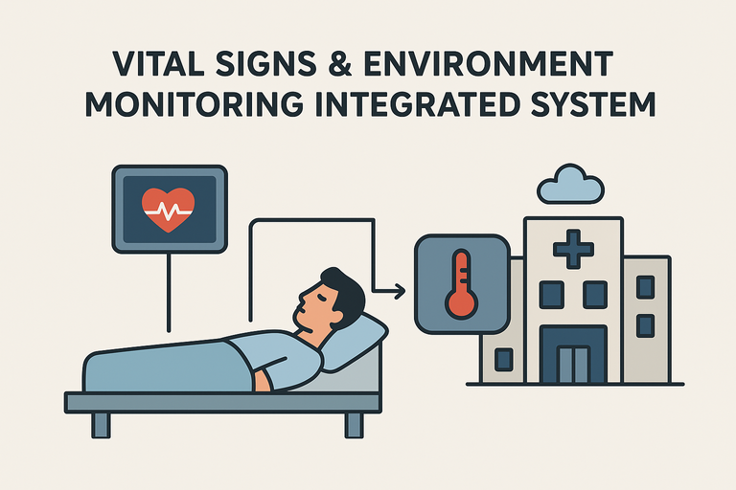
Objective
To develop an automated patient monitoring system for hospital rooms that continuously tracks vital signs and air quality. The system will detect critical changes such as a sudden drop in heart rate or deteriorating room conditions and generate real-time alerts to medical staff, enabling timely intervention and improving overall patient safety.

Slide 5

Existing works
Most systems monitor either vitals or air quality, not both.
Health monitoring with MQTT and Node-RED (no air quality integration).
Air quality monitoring in smart homes (no vitals monitoring).
ESP32-based vital tracking (personal use, not hospital-focused).
ICU systems exist but are costly and not flexible.

Slide 6
Literature survey
Studies highlight MQTT as a lightweight and reliable protocol for real-time health data transfer, suitable for resource-constrained devices.
Research indicates that such visualization tools improve usability for medical staff.
MQTT ensures fast communication between patients’ devices and hospital servers.
Applied for flow-based control but not deeply integrated with hospital infrastructure.

Slide 7








System Design
Sensor
Microcontroller
Sensor
MQTT
Publisher
MQTT
Subscriber
Server
(MQTT Broker)
Microcontroller
Database
Analysis
Actuator
Alert

Slide 8
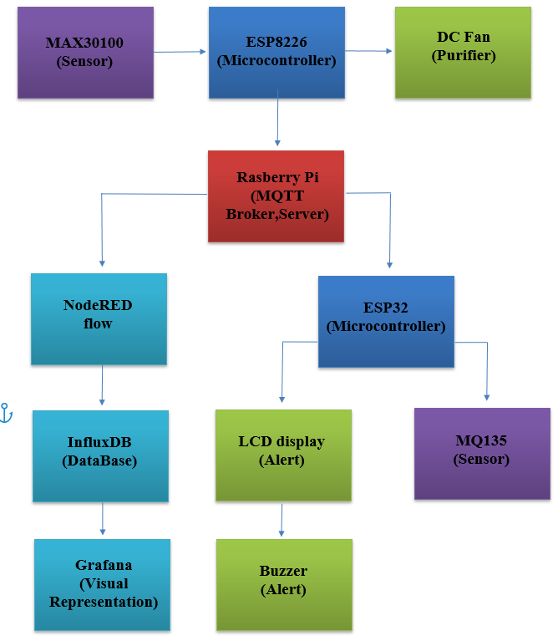
Block Diagram

Slide 9
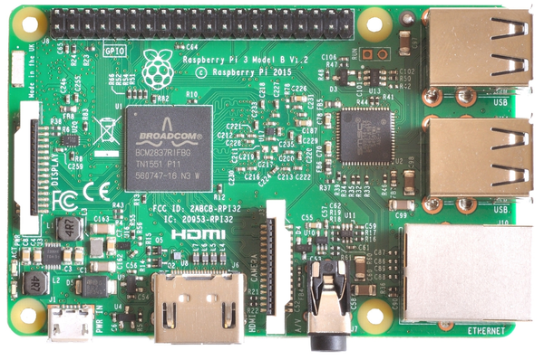
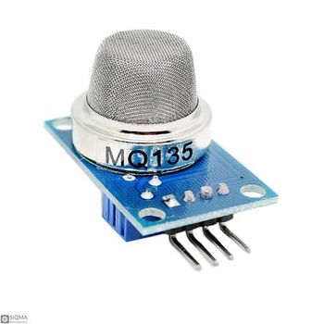
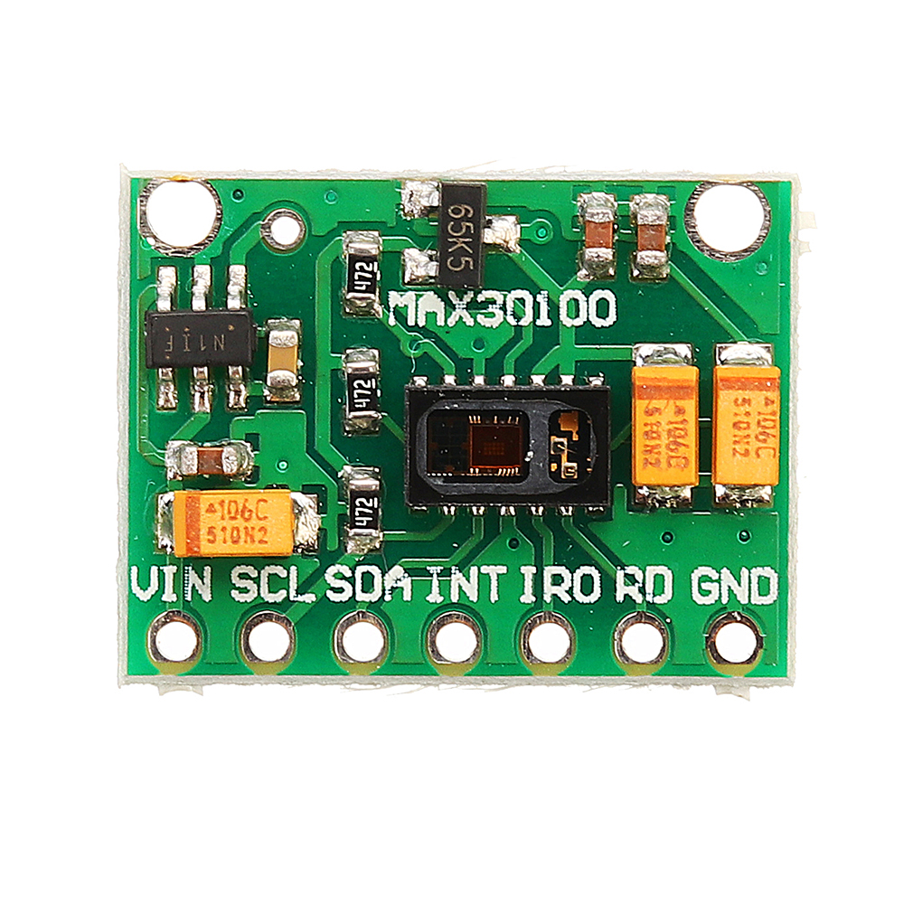
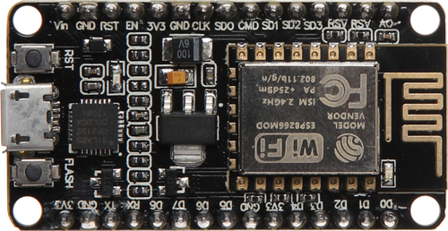
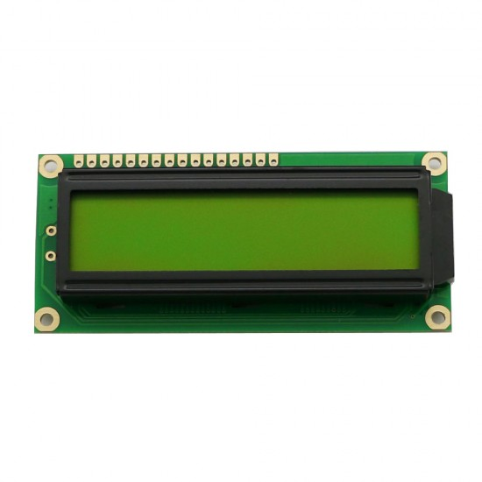
Components Used
Raspberry Pi 3 Model B v1.2
MQ135 Sensor
Heart Sensor
Esp8266 NodeMcu2
16x2 LCD Display

Slide 10
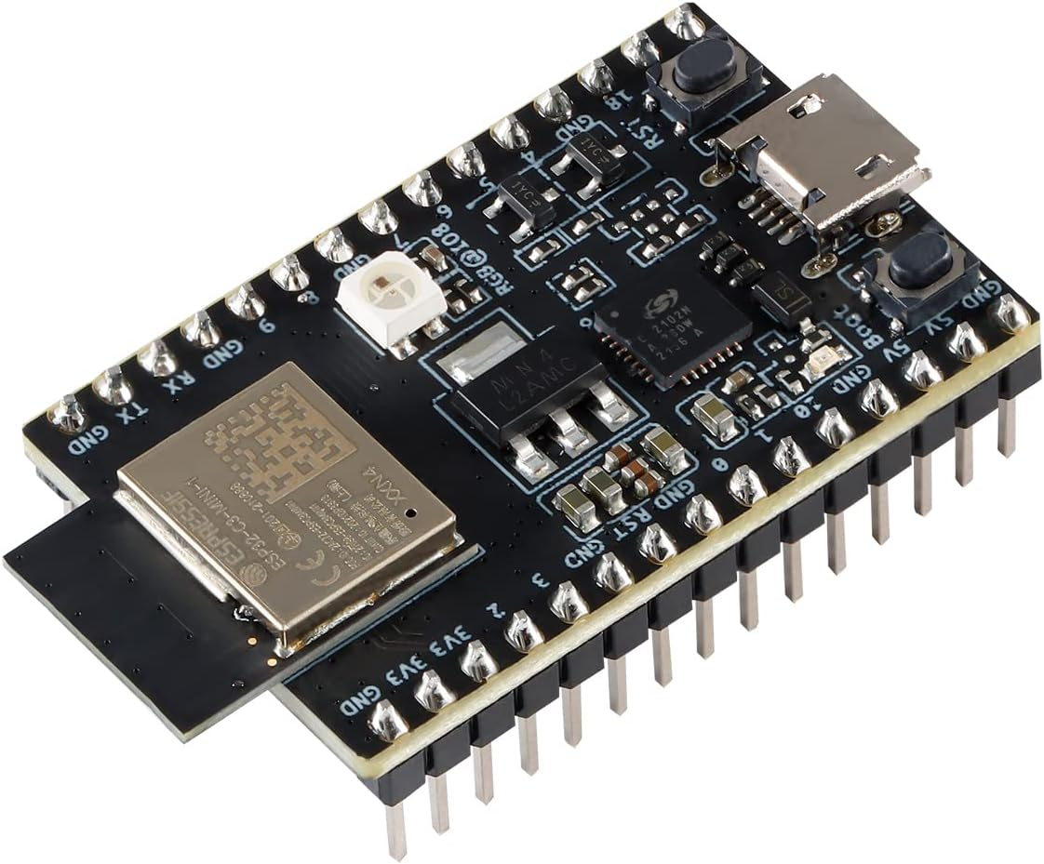
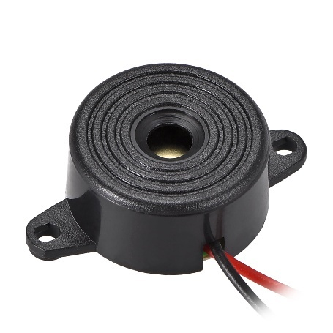
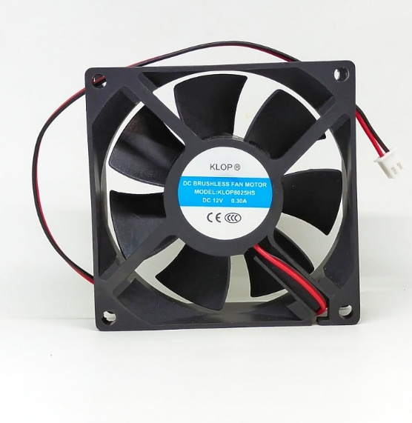
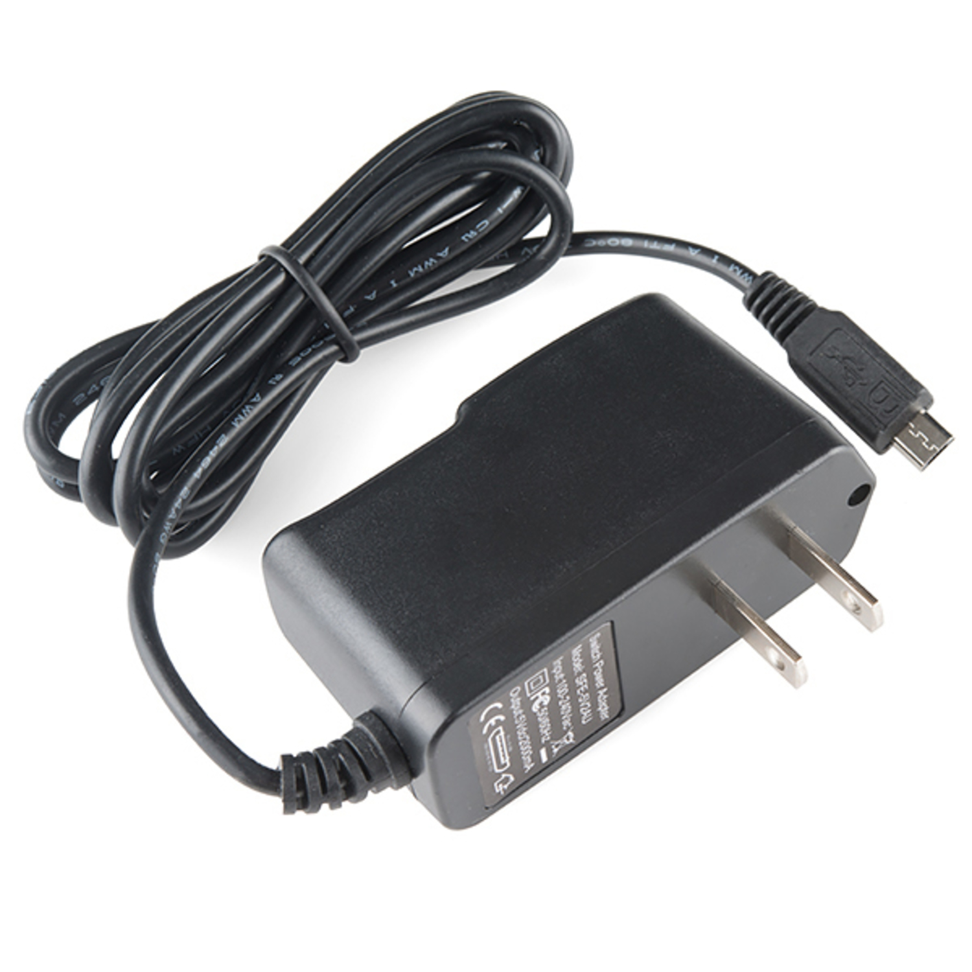
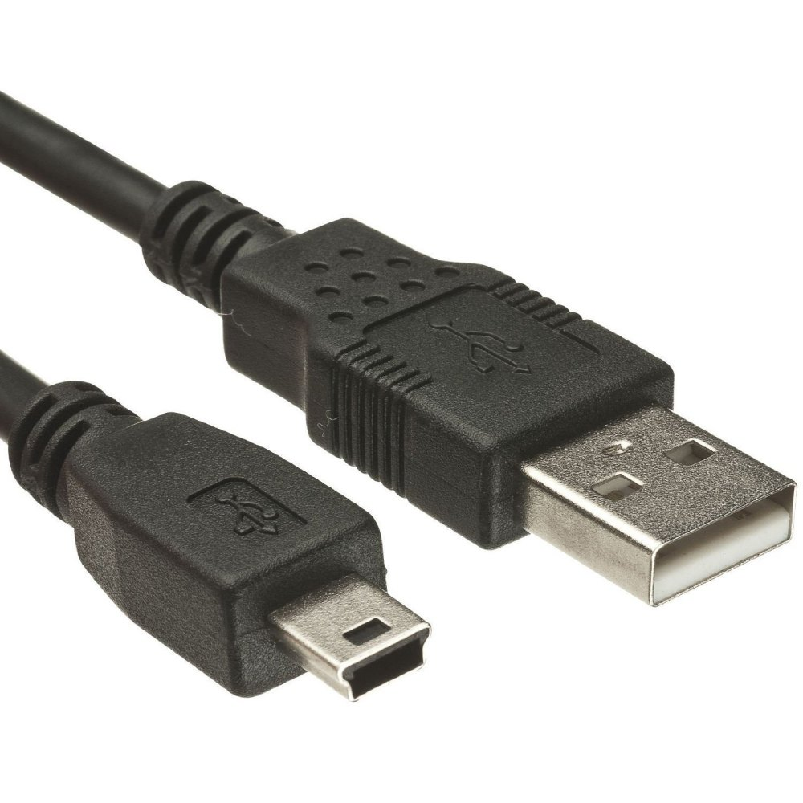
Components Used
ESP32
5V Buzzer
12V DC Fan
5V power Adapter
USB Cable

Slide 11








Tech Stacks
Operating System
Frontend
Backend Services
Raspberry Pi OS Lite (64 bit)
Grafana
Mosquitto
Node-Red
Database
Containerization & Management
Dev Tools
InfluxDB
Docker
Portainer.io
CLI

Slide 12
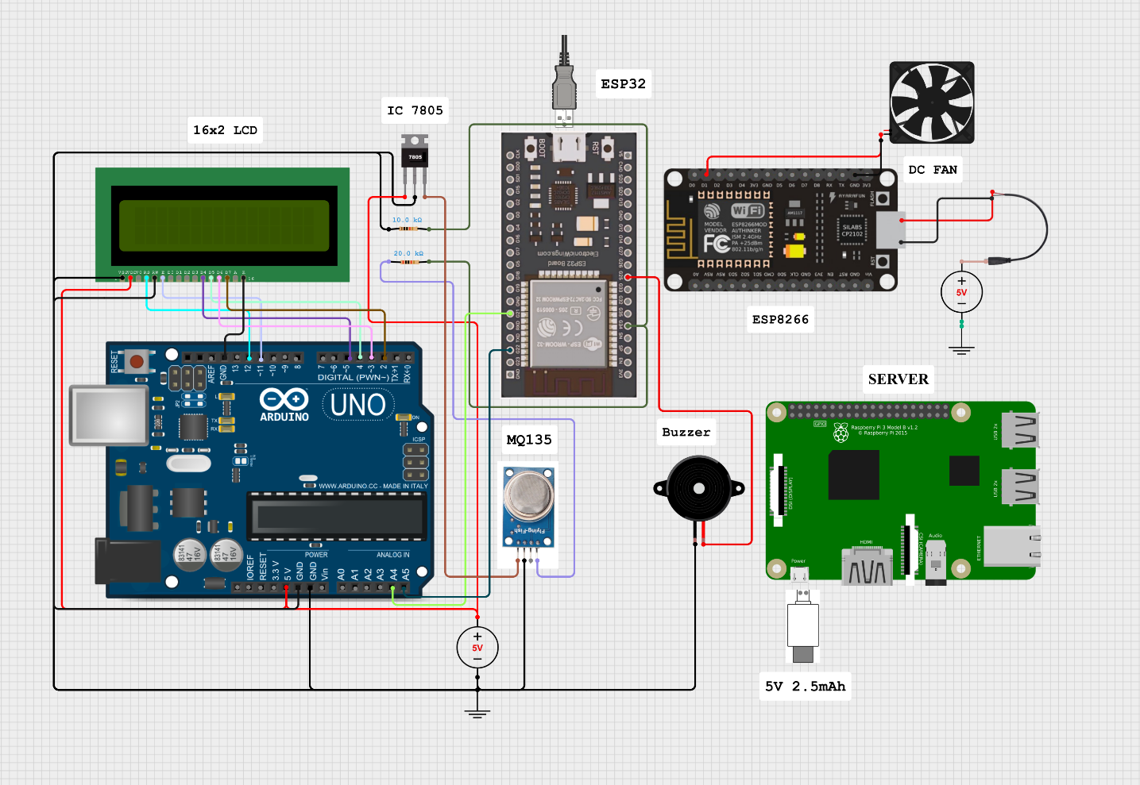
Circuit Diagram

Slide 13
Working
Data Acquisition Layer – Collects real-time data from MQ135 (air quality) and MAX30100 (heart rate) using ESP32 microcontrollers at 1-second intervals.
Wireless Communication System – Transmits sensor data via MQTT protocol through Raspberry Pi–hosted Mosquitto broker using topic-based communication.
Data Processing & Automation Engine – Node-RED processes incoming data, compares with threshold values, and triggers automation within 800 ms.

Slide 14
Working
Data Storage & Management – InfluxDB stores time-stamped sensor readings with optimized retention and query efficiency.
Multi-Modal Alerting & Actuation – Activates DC fan, buzzer, and LCD display through relay and I²C communication upon threshold breach.
Visualization & Monitoring Interface – Grafana dashboard provides real-time visualization, historical trends, and alert indicators.
Containerized Infrastructure – Dockerized setup on Raspberry Pi runs Node-RED, MQTT, InfluxDB, and Grafana under Portainer for efficient management.

Slide 15
Working
End-to-End Data Pipeline – Complete flow from sensor collection → MQTT transmission → Node-RED processing → InfluxDB storage → Grafana visualization → actuator response.
System Integration Features – Modular, fault-tolerant design with sub-2 s response and scalability for future sensor expansion.
Outcome & Reliability – Delivers a unified, automated healthcare monitoring system ensuring timely alerts and improved patient safety.

Slide 16
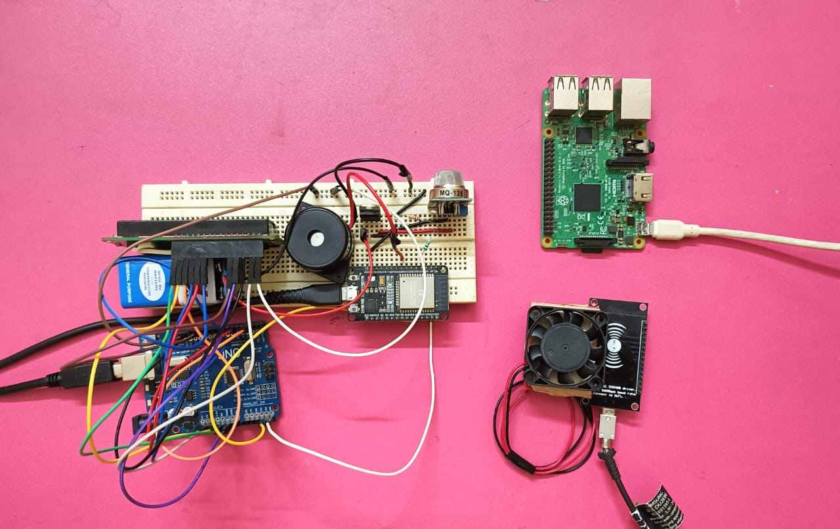
Prototype/Working Model

Slide 17
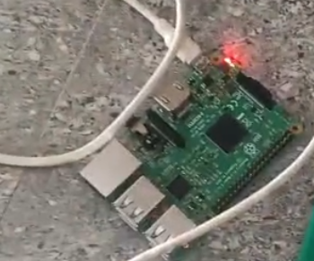
Server – Running state
The Raspberry Pi 3 serves as the central server, managing data from sensors and actuators in real time.
It runs Node-RED, MQTT, InfluxDB, and Grafana inside Docker containers for automation and visualization.

Slide 18
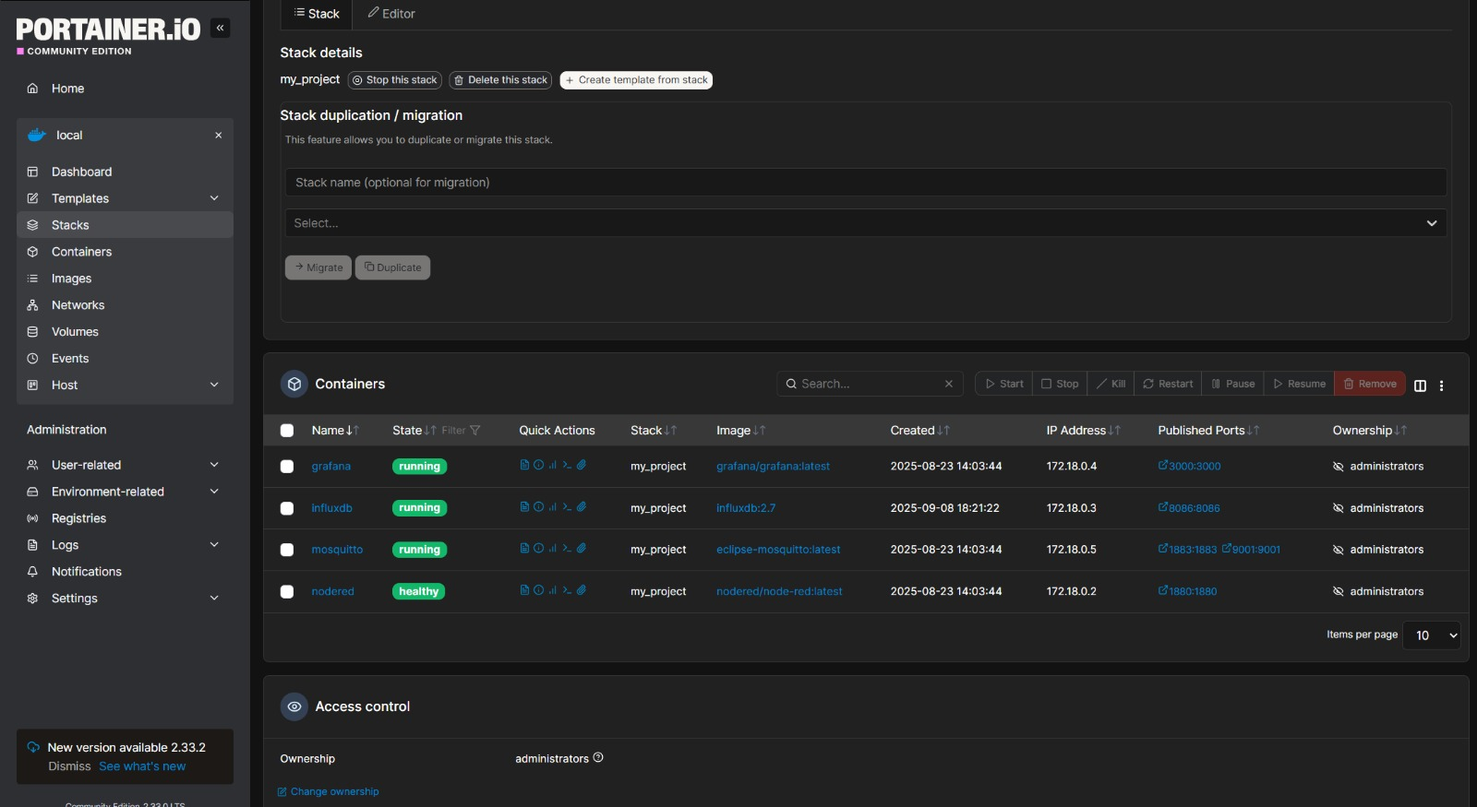
Docker Dashboard
All SERVICES Healthy and Running

Slide 19
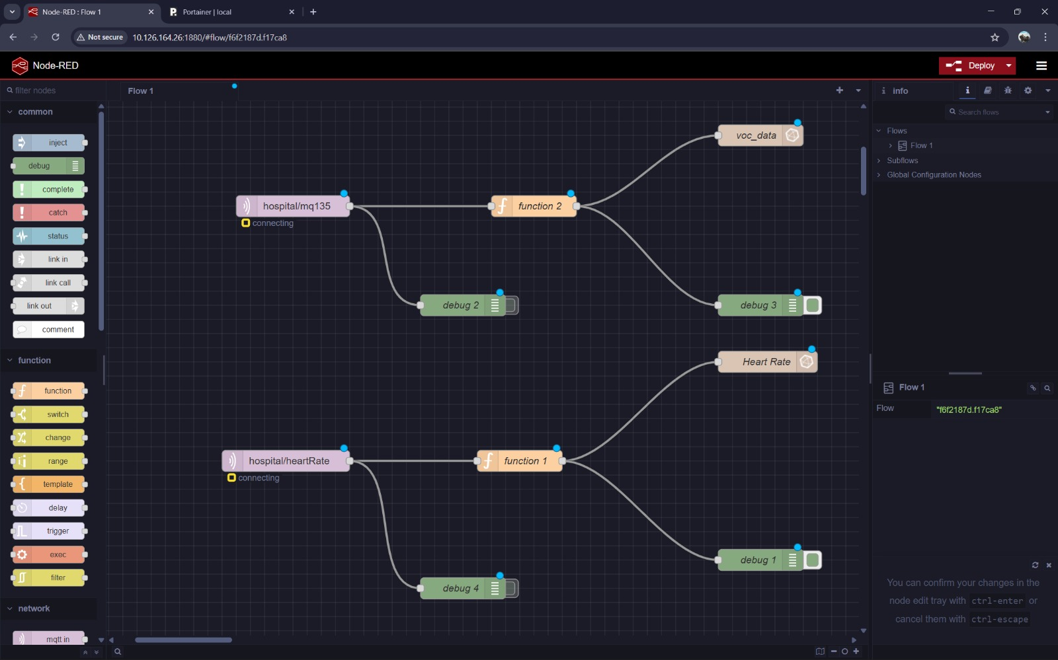
Node-RED Flow Management
Flow for Voc and Heart Rate

Slide 20
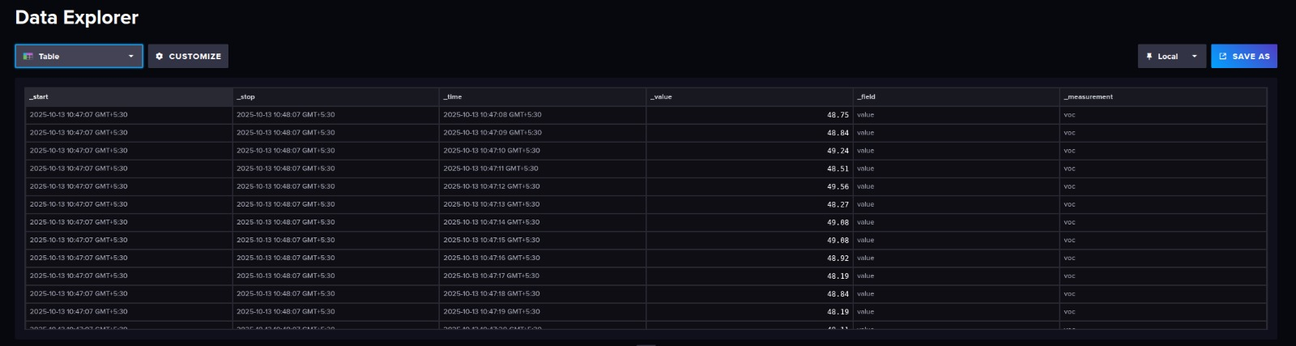
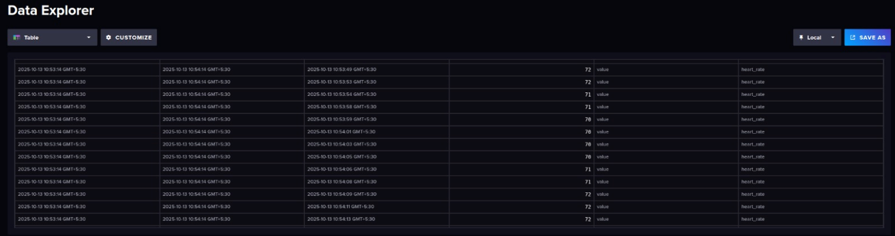
InfluxDB Dashboard
DATA Logging of Voc and Heart Rate in database

Slide 21
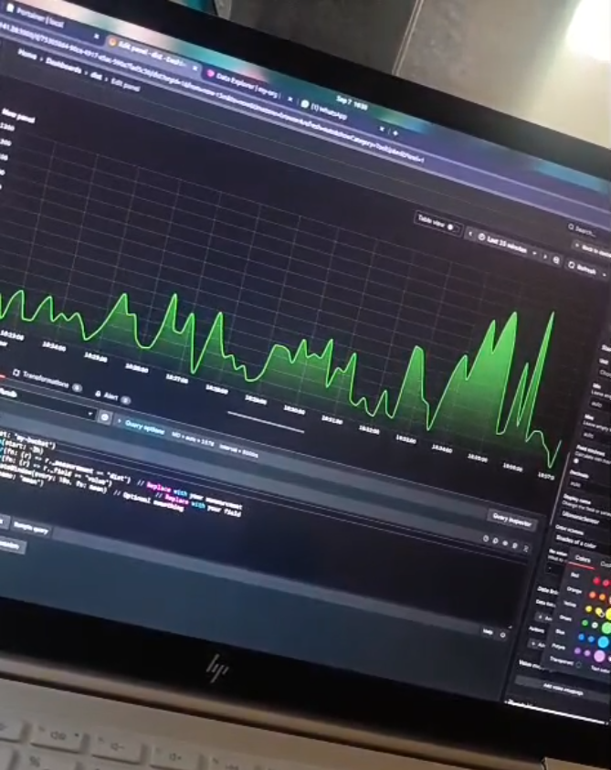
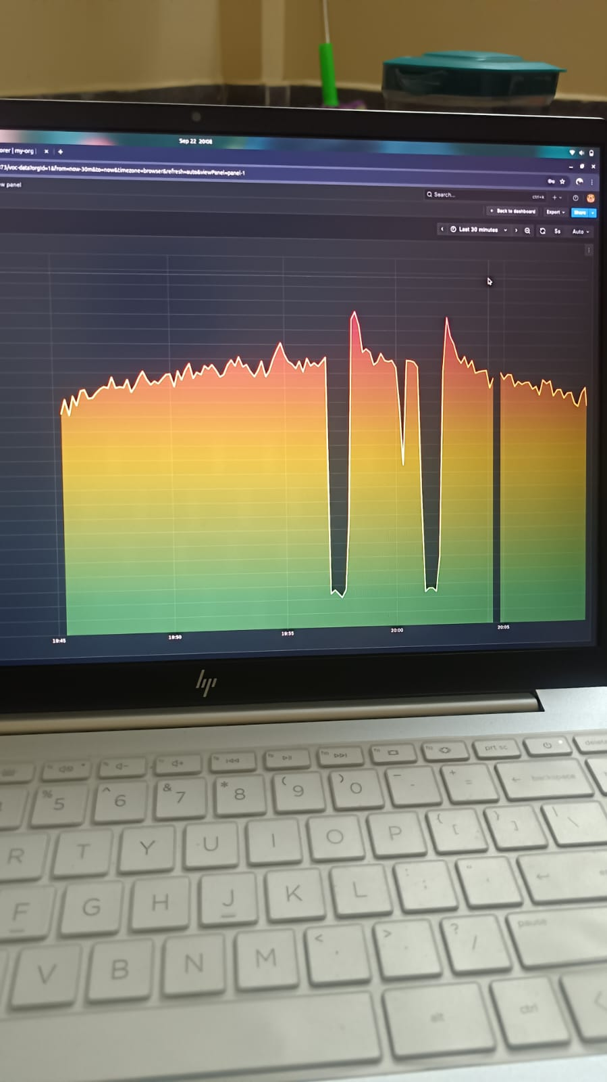
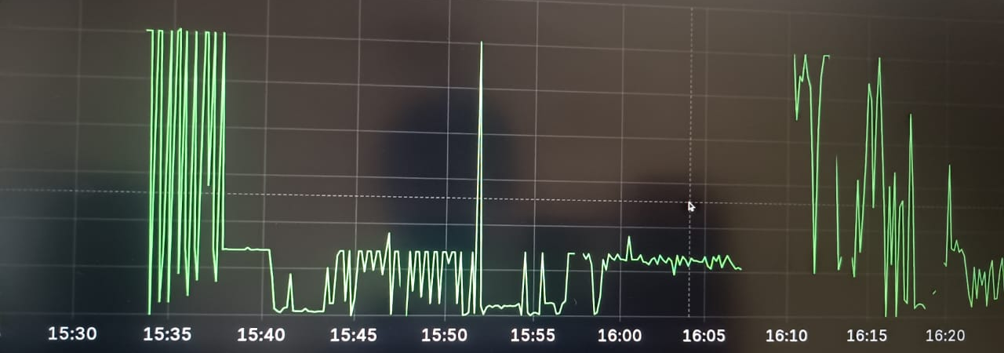
Results

Slide 22
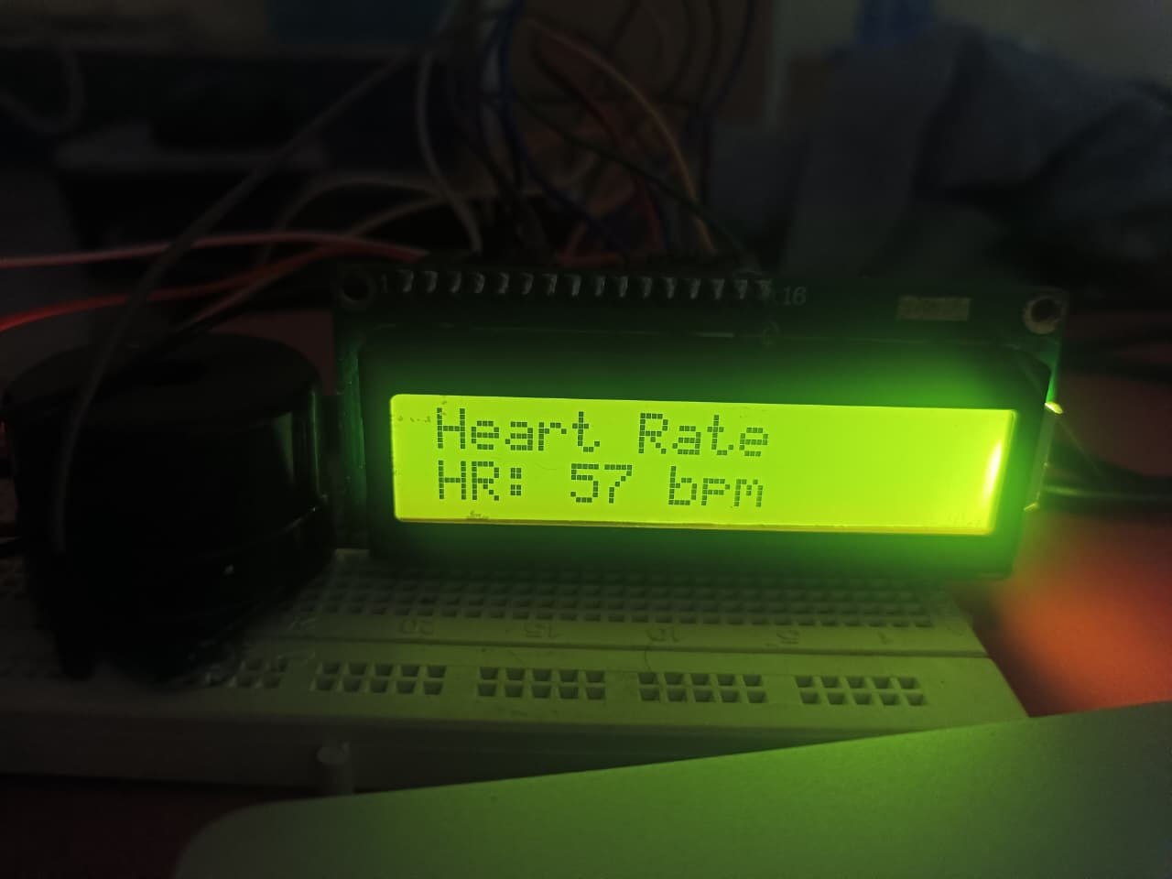
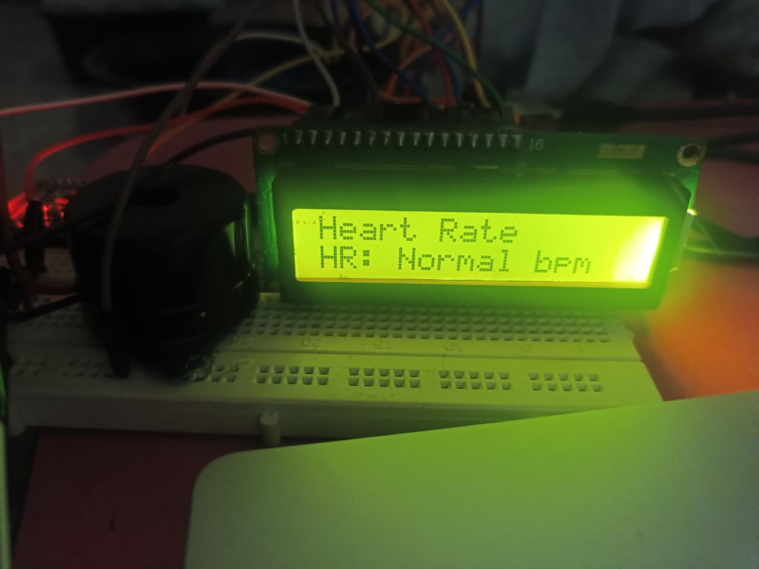
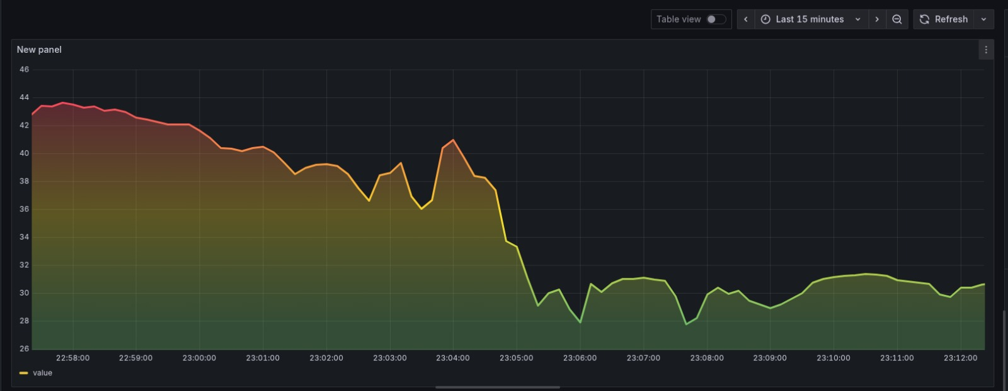
Results

Slide 23
Conclusion
The healthcare automation system successfully demonstrated the integration of IoT technologies for comprehensive patient and environmental monitoring. The results confirm that the MQTT-based communication, Node-RED processing, and containerized deployment provide a robust foundation for healthcare applications. The system's performance in real-time monitoring, automated alerting, and data management meets the requirements for practical healthcare deployment, while the modular design ensures adaptability for future enhancements and scaling.

Slide 24
Future Scope
Based on the implementation experience and results, several improvement opportunities were identified:
Advanced Analytics: Implement machine learning for predictive alerting
Multi-patient Support: Scale architecture for ward-level monitoring
Battery Backup: Integrate UPS for power failure protection
Mobile Integration: Develop companion mobile application
Advanced Sensors: Incorporate additional physiological parameters (SpO2, temperature)

Slide 25
References
"Internet of Things: A Hands-On-Approach" – Arshdeep Bahga, Vijay Madisetti Covers MQTT, IoT architectures, and real-time health monitoring use cases.
"Medical Instrumentation: Application and Design" – John G. Webster Explains heart rate monitoring and sensor integration in healthcare systems.
Node-RED Based Framework for Healthcare IoT Systems Low-Cost IoT-Based Health Monitoring System for COVID-19 Patients Journal of Healthcare Engineering, 2021 - (https://www.irjet.net/archives/V9/i1/IRJET-V9I1282.pdf )

